Slide 1





Emotion Recognition
The process of a computer reading your pretty face
Rec. Img
Identify Face
Process Input
Img Shape
Analysis
Open CV
Normalize
Numpy

Slide 2

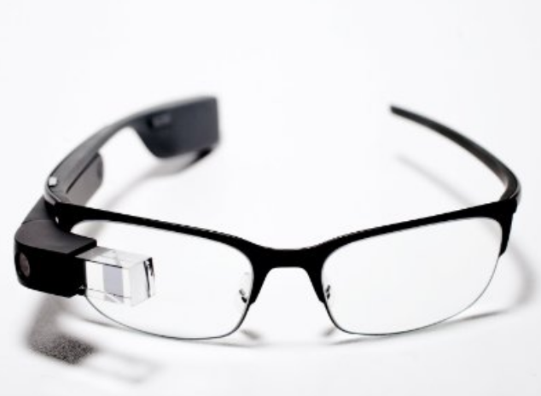
Open Source Computer Vision
Computer Vison and Machine Learning Algorithms
Used for detection, tracking, image stitching, etc.

Slide 3
Pretrained Models
OpenCV’s frontal face classifier to detect faces
Uses Haar Feature-based cascade classifiers
Keras CNN to detect emotion
Trained by oarriaga using Keras and FER2013 dataset

Slide 4
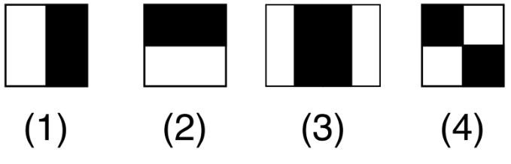
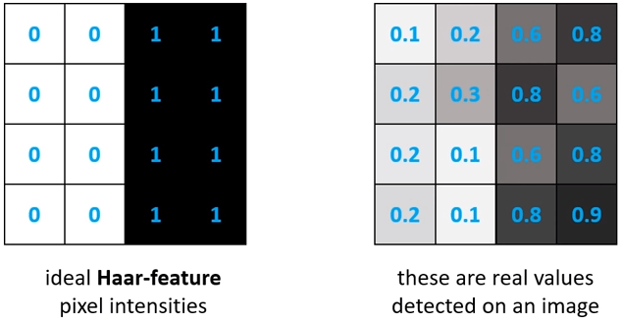
Haar-features
Used to detect edges and lines
Sums pixel intensities in each region and calculates the difference

Slide 5
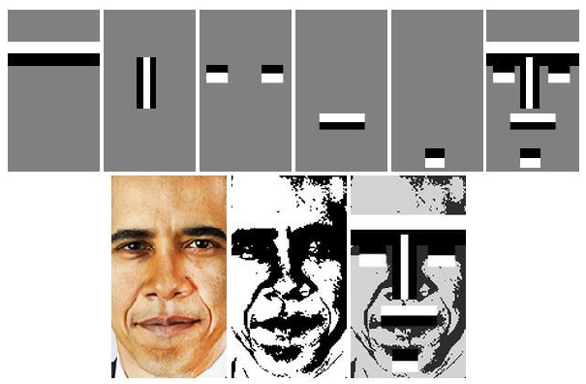
Haar-features
Kadir, Kushsairy Abdul et al. “A comparative study between LBP and Haar-like features for Face Detection using OpenCV.” 2014 4th International Conference on Engineering Technology and Technopreneuship (ICE2T) (2014): 335-339.

Slide 6
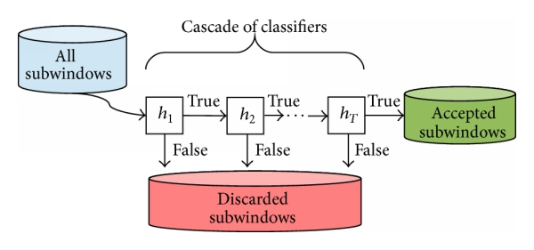


Slide 7
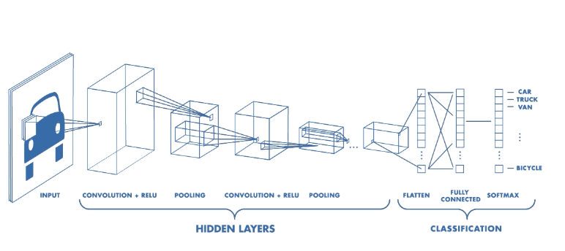
Emotion Model
Convolutional Neural Network
Model used was created by GitHub user: oarriaga.
https://github.com/oarriaga/face_classification
Architecture of a CNN. — Source: https://www.mathworks.com/videos/introduction-to-deep-learning-what-are-convolutional-neural-networks--1489512765771.html

Slide 8
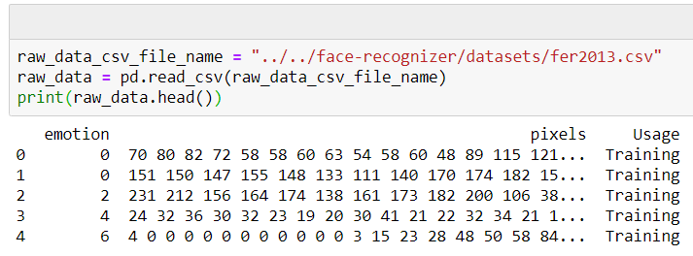
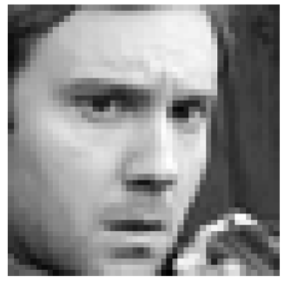
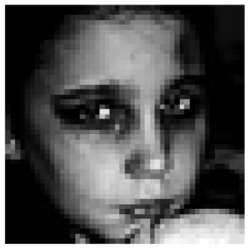
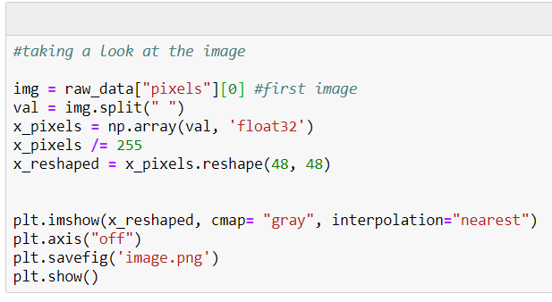
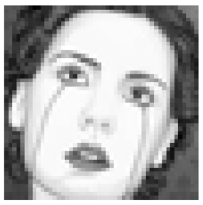
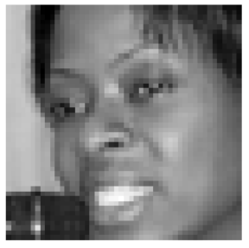
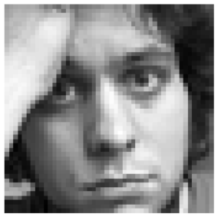
FER2013 Dataset

Slide 9
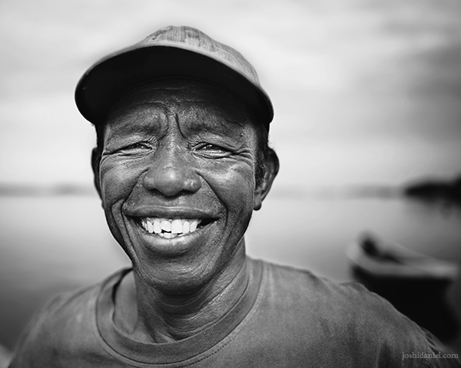
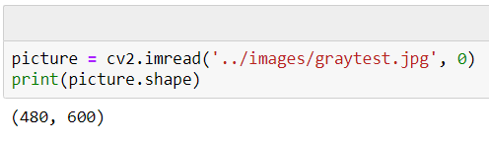
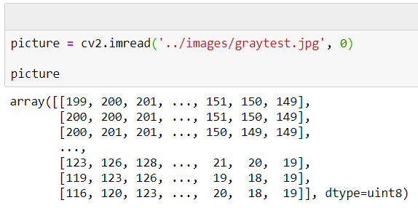
Use Open CV to Read Images
600 x 480

Slide 10
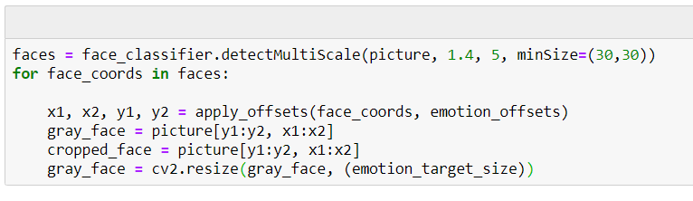
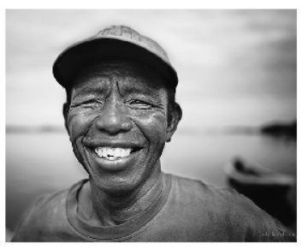
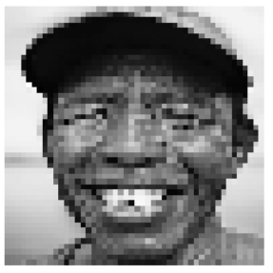
Detect, crop, and reshape the image
48
48

Slide 11
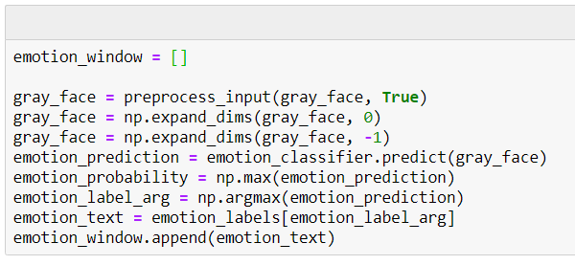
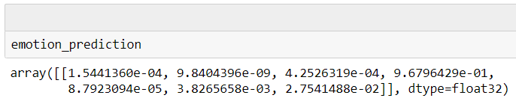
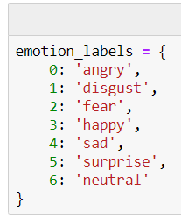
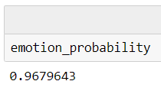
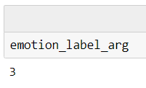
Preprocess and run through emotion model
Demo

Slide 12
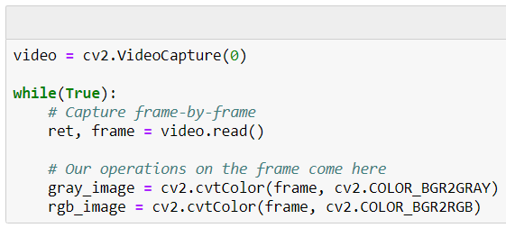
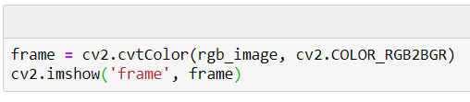
Updating the code to allow for video input
The cv2.VideoCapture(0) is running a loop, and returns the same type of array as the image.
The video also captures the colored version of the frame to display to the user.

Slide 13
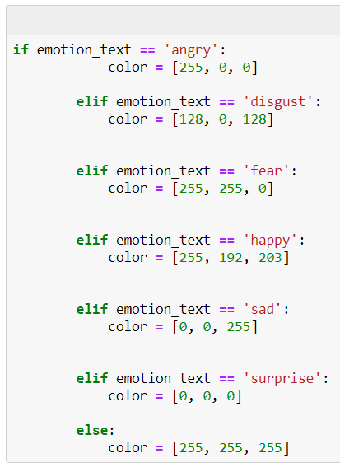
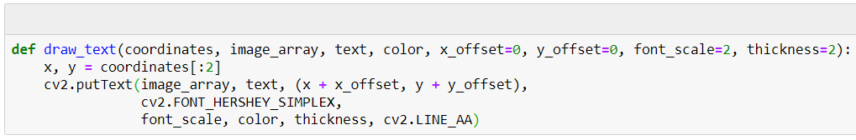
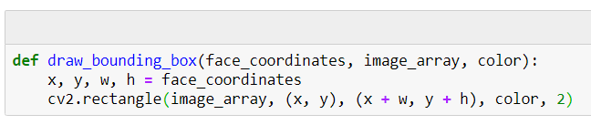
Video input draw box and emotion
Demo

Slide 14
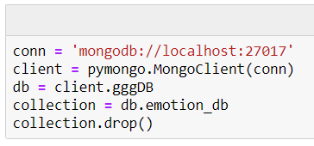
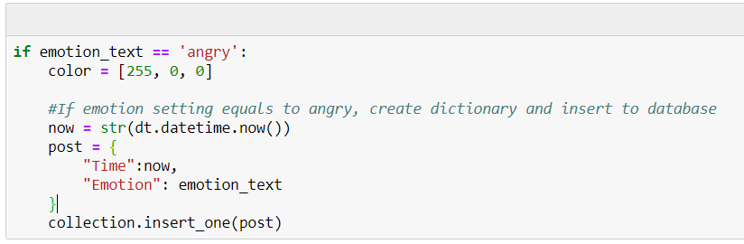
Capture data and store

Slide 15
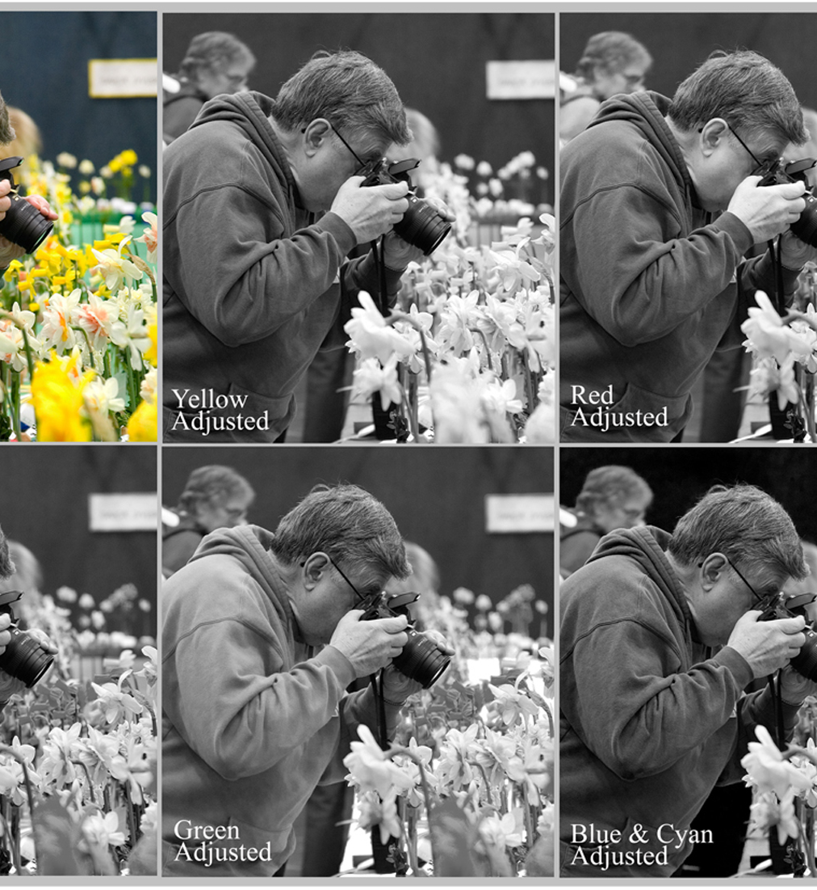
Preprocess_input()
Normalize all the pixels
Reason: That’s how the model was trained…?
It helps clearing the noise from different light setting
Imagine a very dark setting image vs a very light setting image

Slide 16
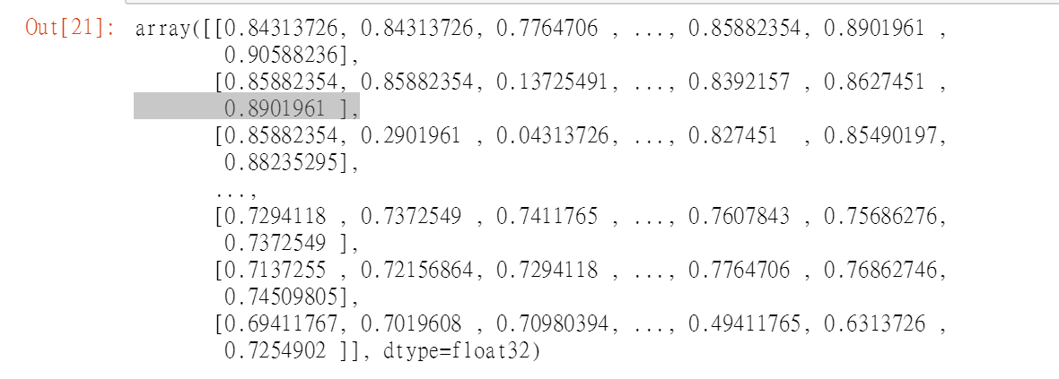
Image Shape
The image is an 48 by 48 array of pixels
Computer doesn’t understand it.
Np.expand_dims(processed, 0) add one bracket to the array, or adding one dimension to it.
Np.expand_dims(processed, -1) add one bracket to each pixel

Slide 17
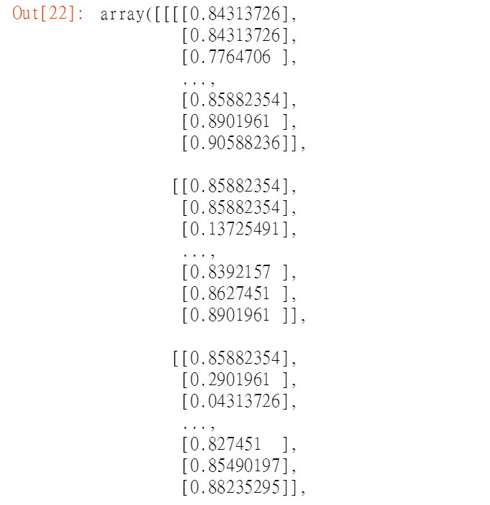
Image shape cont.
What does that all mean?????
By changing it to a (1,48,48,1) array from (48,48) you are telling the machine, there is one picture of 48 by 48 pixel with one kind of color.
Color pixel would be (1,48,48,3) where each pixel is an array of 3 color element, or the rgb(255,255,255)

